Slide 1
Design of a Safety-First Hardware Design Language
Lennart Van Hirtum
Prof. Christian Plessl - Promotor
NHR Summer School, Paderborn University, 12-16 June 2023

Slide 2



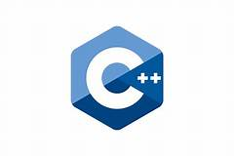










Motivation
Software Languages
Hardware Languages
Low Level
Control
Low Level
Control
??
TL-Verilog
Safety
Safety

Slide 3
Why not existing RTL languages?
Verilog/VHDL are Industry standard
Can describe any hardware
Incredibly verbose
Bugs are common & difficult to find!

Slide 4
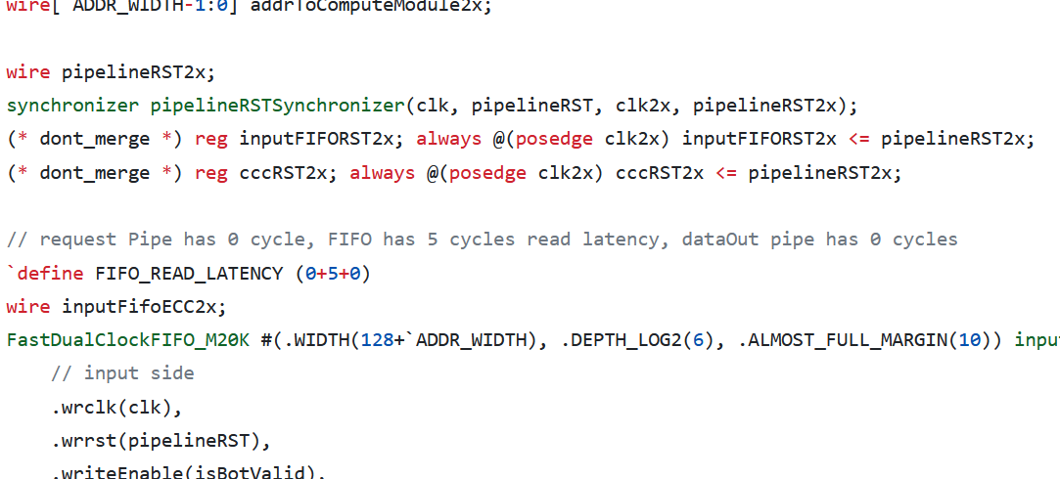
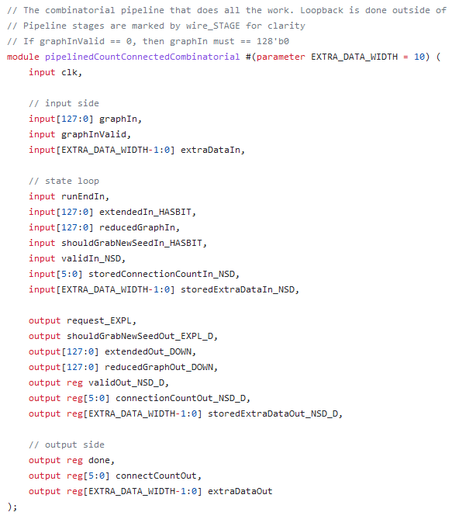
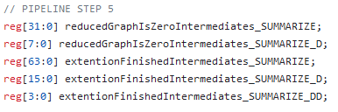
This is REAL Verilog code, written by REAL programmers!
?????????
?????????????????
????????????????????????

Slide 5
What to improve?
80% of time is spent debugging and fiddling!
Improve debuggability
Readability → HLS does this well
Tooling & User feedback → Most are behind by decades
Prevent Bugs → No one really does this
Make common modifications easy

Slide 6
github.com/pc2/sus-compiler

Slide 7
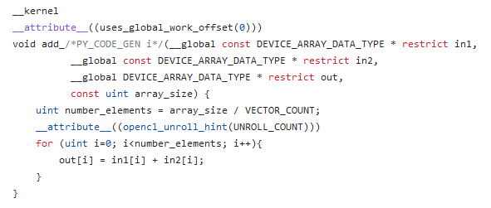
Why not HLS?
Very Compact
Good-ish results on most designs
Imperative nature of HLS does not map to hardware
Clever compilers
But much fiddling
Little control
Proprietary

Slide 8
Appendix

Slide 9
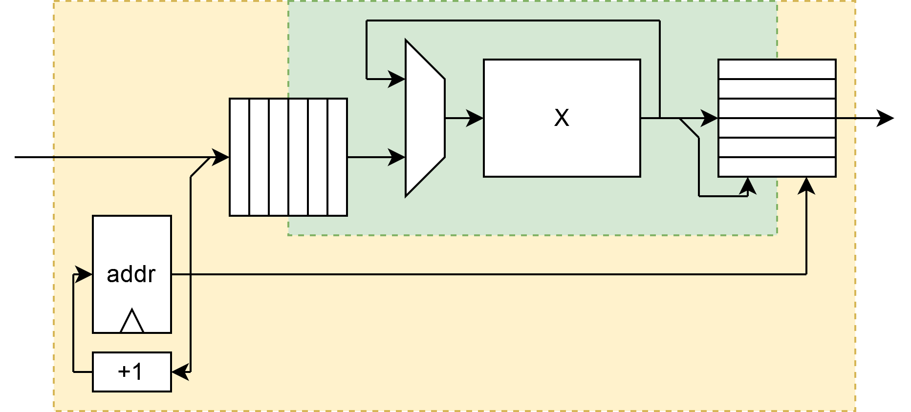
Plan of attack
New RTL Language
As easy to use as HLS
Stay low-level
More Type-safety!
More Time-safety!
Focus on tools!

Slide 10
Inspirations
TL-Verilog
Filament
Chisel
Rust 🦀

